Slide 1

C++ Project
TITLE : FINDLIST
19011558 서상민

Slide 2
INDEX
1. Summary
2. Program Execution Process
3. Describe Entire Code

Slide 3
Summary
▶ This is a program that user can find the list what he or she wants.
That’s Hilarious
STAY
Light Switch
As It Was
Stronger
Off My Face
All 4 Nothing
2step
Bad Habits
abcdefu
STAY
2step
using functions
BEFORE
AFTER
(Example)

Slide 4
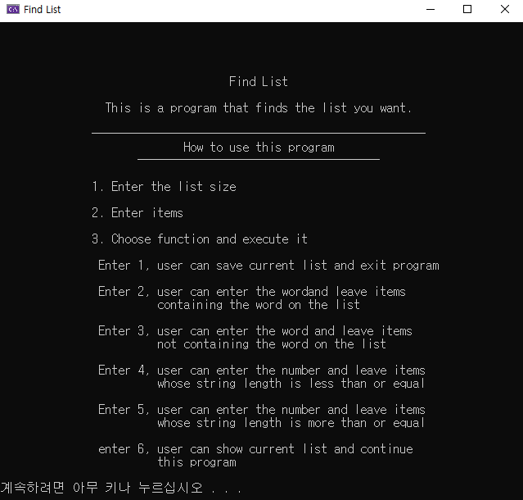
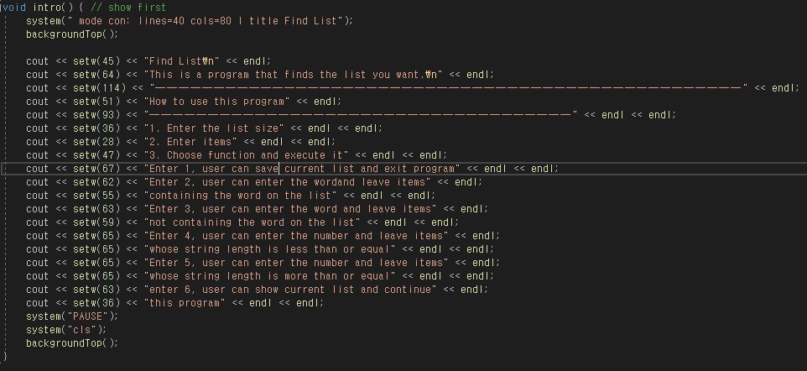
Program Execution Process
The First Screen
▶ Make it easy for users to use the program by using
console size control and design.
Console
Code

Slide 5
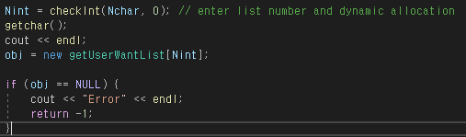
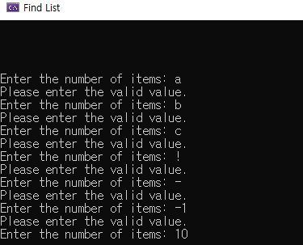
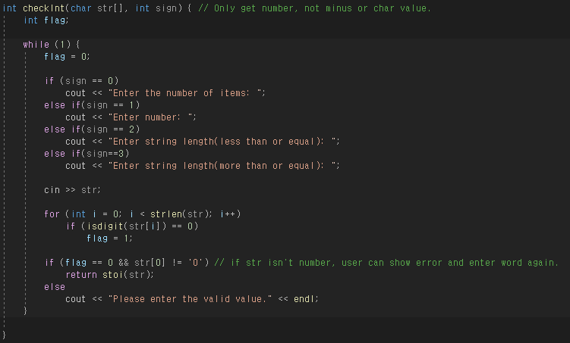
Program Execution Process
1. Enter the list size. ( Input is only positive number )
▶ If an inappropriate input is received, user can see an error statement.
▶ Use dynamic allocation to minimize memory usage.
Console
Code

Slide 6
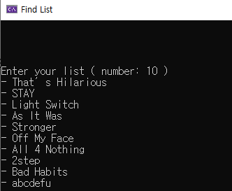

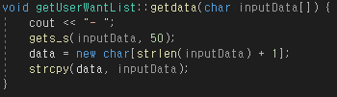
Program Execution Process
2. Enter as many items as user entered in “1”.
▶ Up to 50 characters including spaces
Console
Code

Slide 7
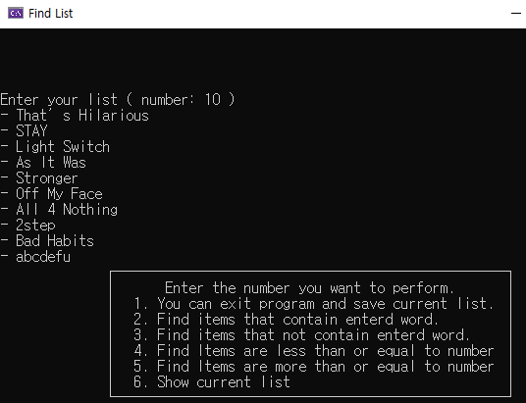
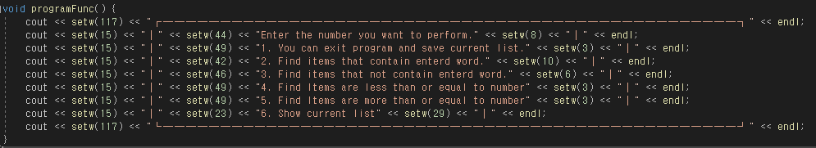
Program Execution Process
3. Choose function and execute it
Console
Code

Slide 8
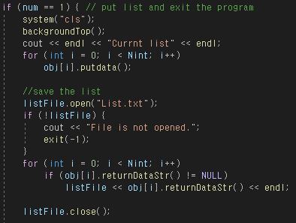
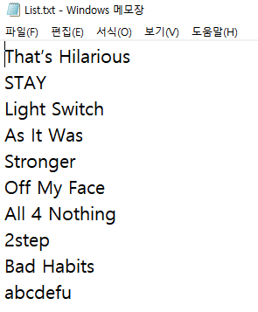
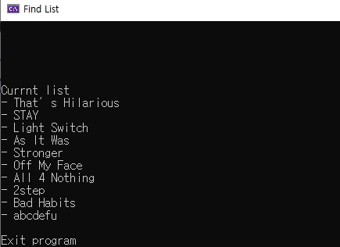

Program Execution Process
3-1. Enter 1, save current list and exit program.
▶ When the program ends, write the list to the .txt file and save it.
Console
Code
Notepad

Slide 9


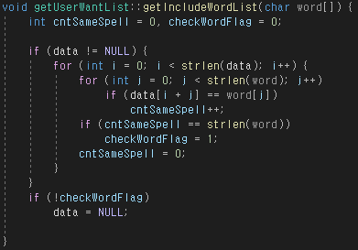

Program Execution Process
3-2. Enter 2, enter the word and leaves items containing the word in the list.
3-6 function
Console
Code

Slide 10


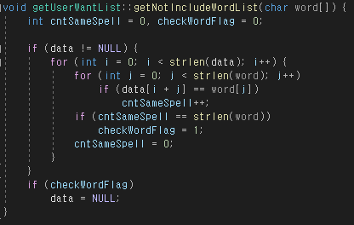
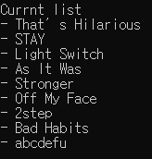
Program Execution Process
3-3. Enter 3, enter the word and leaves items not containing the word in the list.
3-6 function
Console
Code

Slide 11


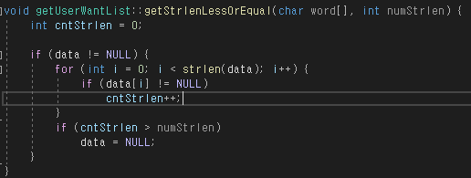

Program Execution Process
3-4. Enter 4, enter a number and leave only items with a string length
less than or equal to that number in the list.
3-6 function
Console
Code

Slide 12


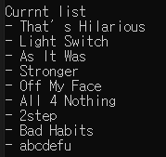
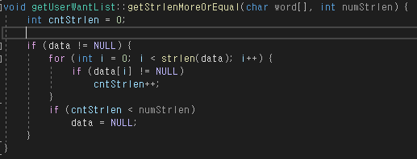
Program Execution Process
3-5. Enter 5, enter a number and leave only items with a string length
more than or equal to that number in the list.
3-6 function
Console
Code

Slide 13
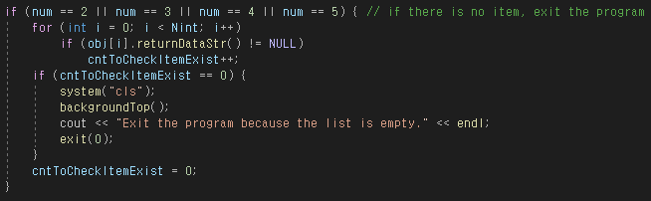
Program Execution Process
3. Choose function and execute it
▶ After using function, If there are no items in the list, exit the program.
Console
Code

Slide 14
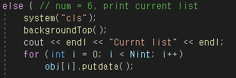
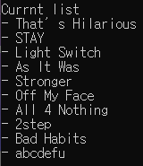

Program Execution Process
3-6. Enter 6, show current list and enter number to use the function again.
Console
Code

Slide 15
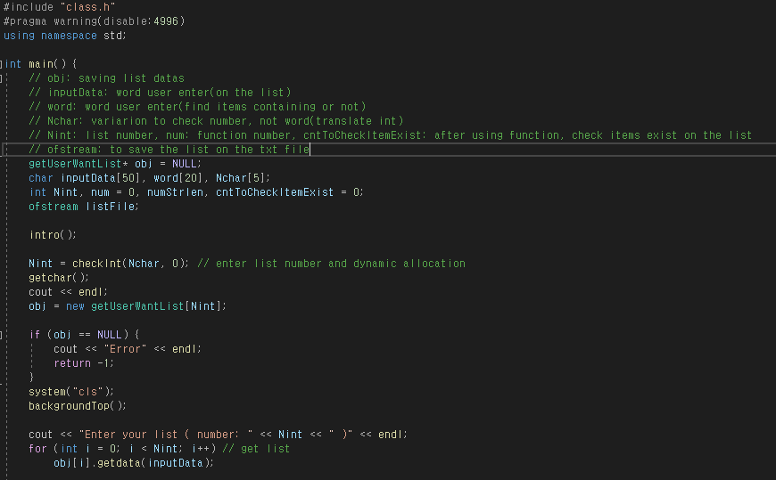
Entire Code
main.cpp
▶ Divide into main.cpp, class.cpp, class.h files to facilitate management.

Slide 16
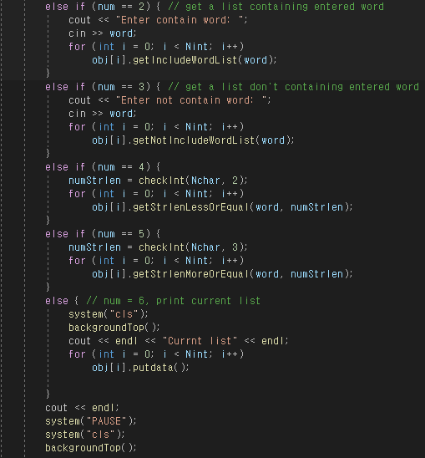
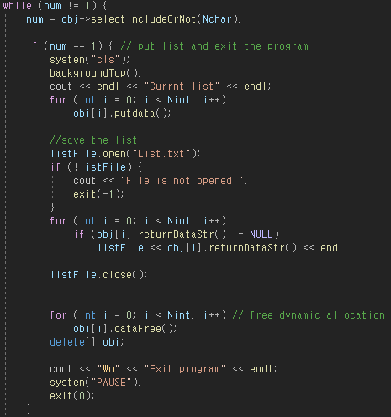
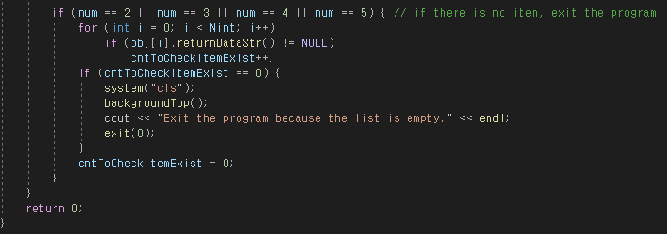
Entire Code
main.cpp

Slide 17
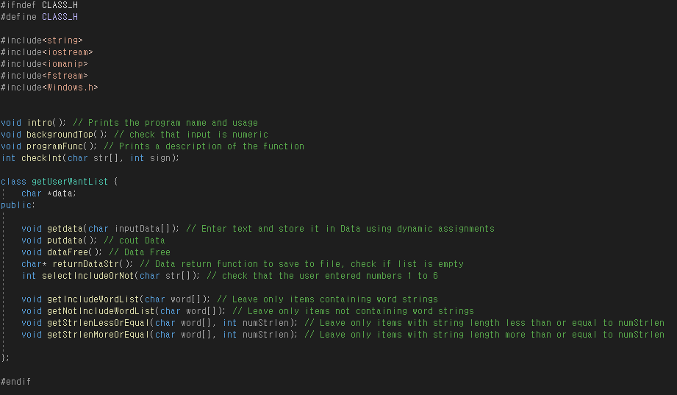
Entire Code
class.h

Slide 18
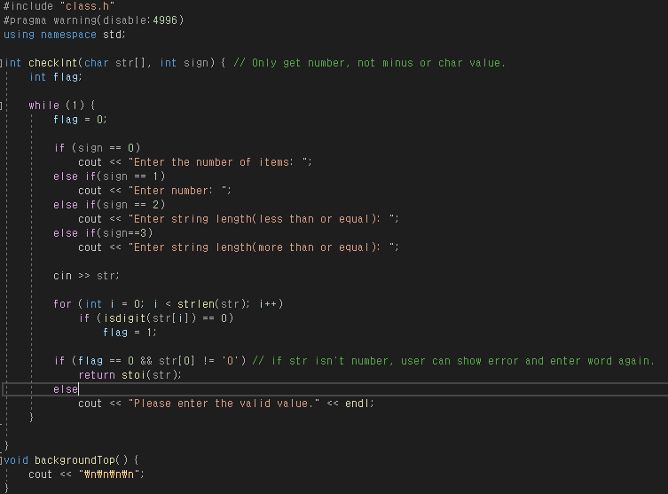
Entire Code
class.cpp - 1

Slide 19
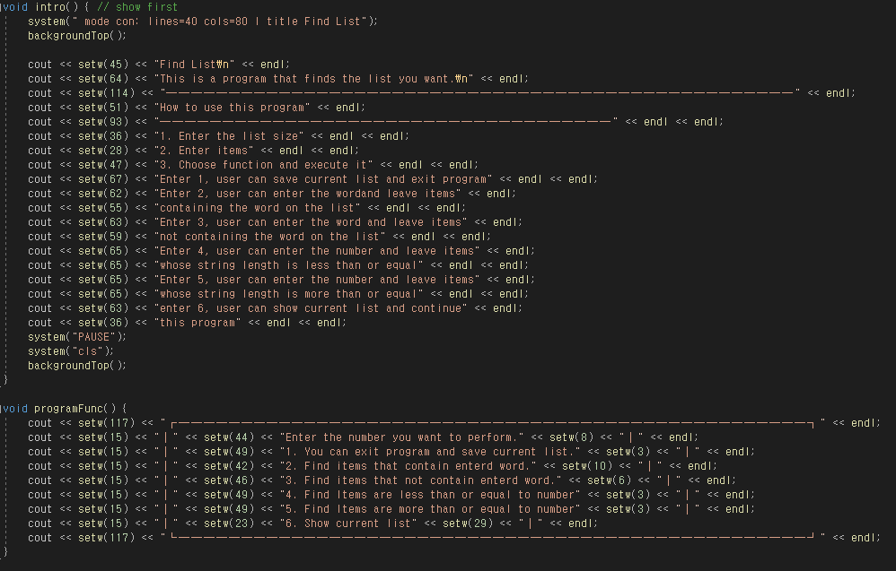
Entire Code
class.cpp - 2

Slide 20
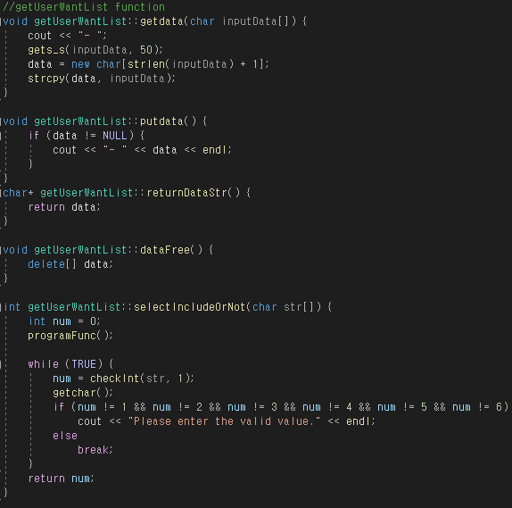
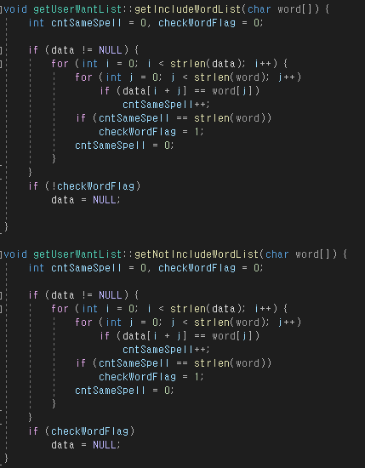
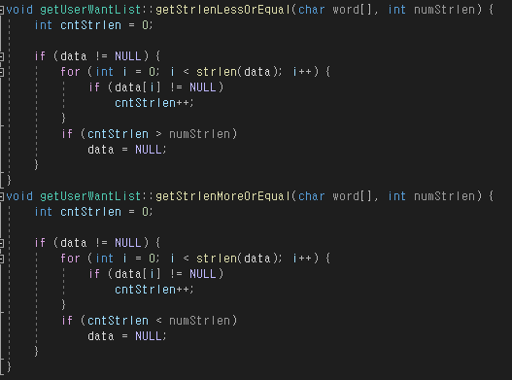
Entire Code
class.cpp - 3

